Slide 1
Twitter Mood Light
An Arduino and Python project by James Woods

Slide 2

Aims and Objectives
Connect to Twitter API
Emotive Analysis
Determine Colour of LED
Live Updates
Notes:
Talk about what each aim involves

Slide 3
The Idea
Concept
Reality
Count Tweet Mood (Arduino Shield)
Run algorithm (Arduino)
Fade to colour (Arduino)
Count emoticons (Python)
Run algorithm(Python)
Send data and change colour (Arduino)
Notes:
First set of points is how I planned it to work
Second is how it actually works. Talk about why I changed it

Slide 4
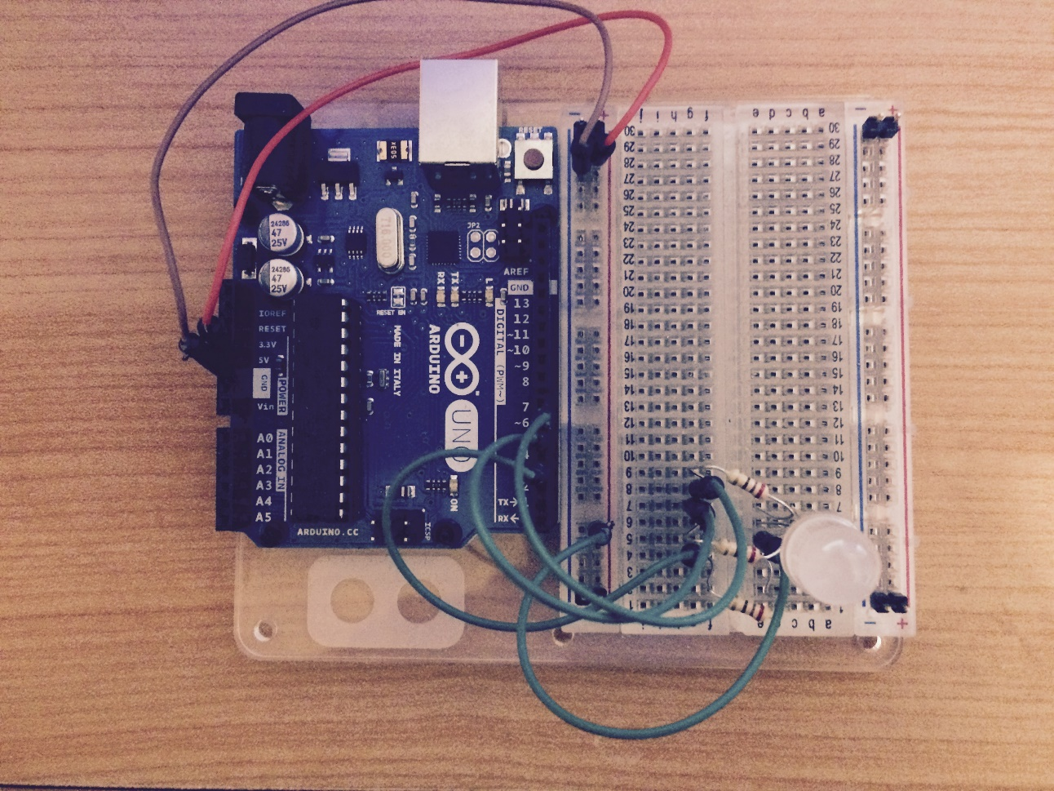
Demonstration
5V
Ground
Pin 6 (Blue)
Pin 5 (Green)
Common Pin (Connect to positive)
Pin 3 (Red)
Notes:
Go To Python Command Line

Slide 5
How it Works
Reset
Python
Arduino
Collect Tweets
‘WhatColor’ Algorithm run
Result sent to Arduino
Serial
Connection
Format data
Timer expires
(5 seconds)
Change LED
Notes:
Talk through flowchart. Starts at reset.

Slide 6
Aims and Objectives Achieved?
Connected to Twitter API
Emotive Analysis
Determine Colour of LED
Live Updates
Python Library for API connection
Emoticon count
‘WhatColor’ algorithm
10 Second reset
Notes:
Talk about why each one has / has not quite been met.

Slide 7
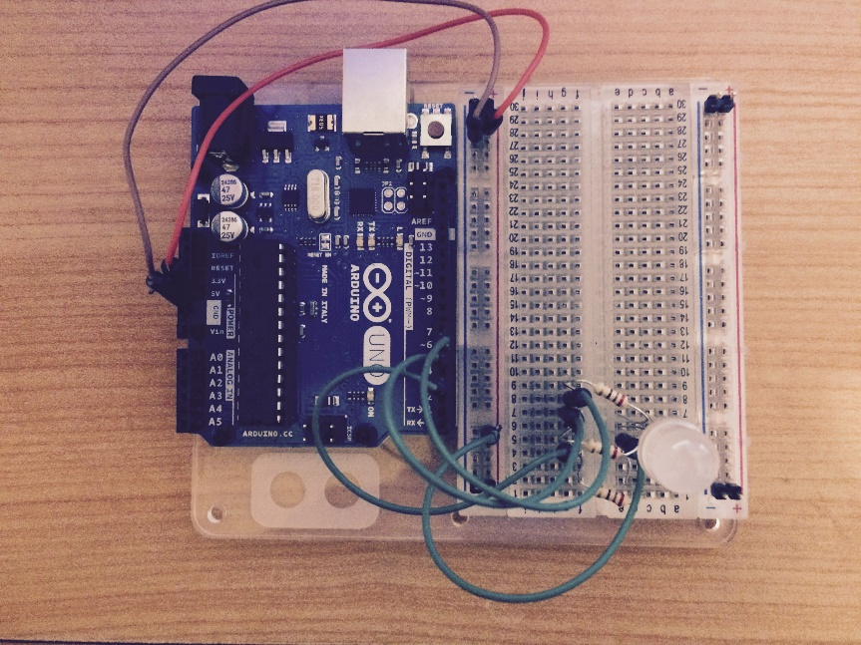
5V
Ground
Pin 6 (Blue)
Pin 5 (Green)
Common Pin (Connect to positive)
Pin 3 (Red)

